Slide 1
Introduction to Deep Learning
Rang Nguyen June 2019

Slide 2
Outline
What is AI, ML, DL?
Why Deep Learning and Why Now?
Review: Perceptron, Neural Network
Introduction to TensorFlow, Keras

Slide 3
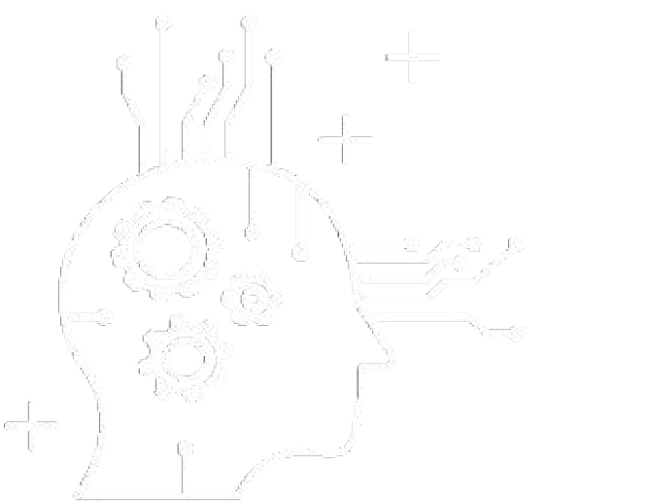
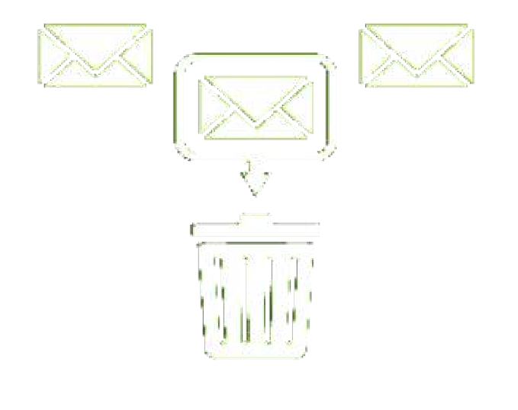
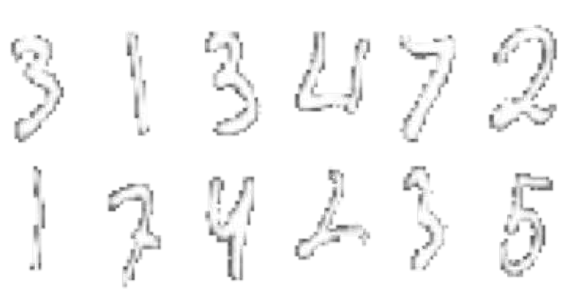
What is Deep Learning?
ARTIFICIAL INTELLIGENCE
Any technique that enables computers to mimic human behavior
MACHINE LEARNING
Ability to learn without explicitly being programmed
DEEP LEARNING
Extract patterns from data using neural networks

Slide 4
Machine Learning Basics
Machine learning is a field of computer science that gives computers the ability to learn without being explicitly programmed
Labeled Data
Machine Learning algorithm
Training
Prediction
Labeled Data
Learned model
Prediction
Methods that can learn from and make predictions on data

Slide 5
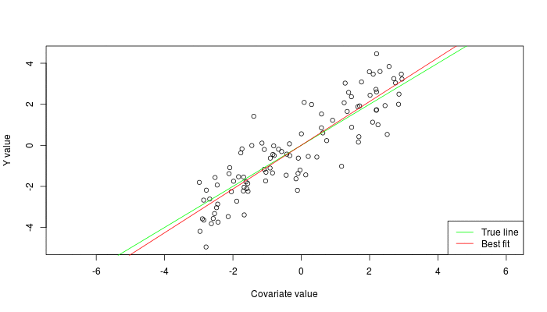


Types of Learning
Supervised: Learning with a labeled training set
Example: email classification with already labeled emails
Unsupervised: Discover patterns in unlabeled data
Example: cluster similar documents based on text
Reinforcement learning: learn to act based on feedback/reward
Example: learn to play Go, reward: win or lose
class A
class B
Classification
Regression
Clustering
Anomaly Detection
Sequence labeling
…
http://mbjoseph.github.io/2013/11/27/measure.html

Slide 6
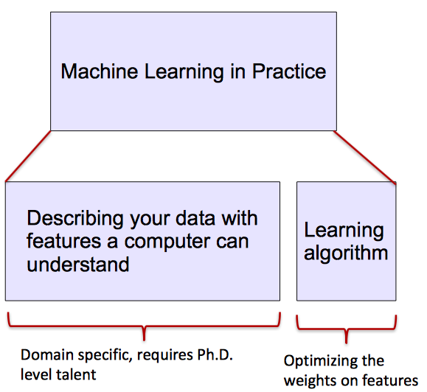
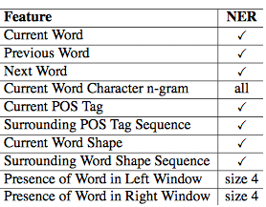
ML vs. Deep Learning
Most machine learning methods work well because of human-designed representations and input features
ML becomes just optimizing weights to best make a final prediction

Slide 7

What is Deep Learning (DL) ?
A machine learning subfield of learning representations of data. Exceptional effective at learning patterns.
Deep learning algorithms attempt to learn (multiple levels of) representation by using a hierarchy of multiple layers
If you provide the system tons of information, it begins to understand it and respond in useful ways.
https://www.xenonstack.com/blog/static/public/uploads/media/machine-learning-vs-deep-learning.png

Slide 8
Why Deep Learning and Why Now?

Slide 9
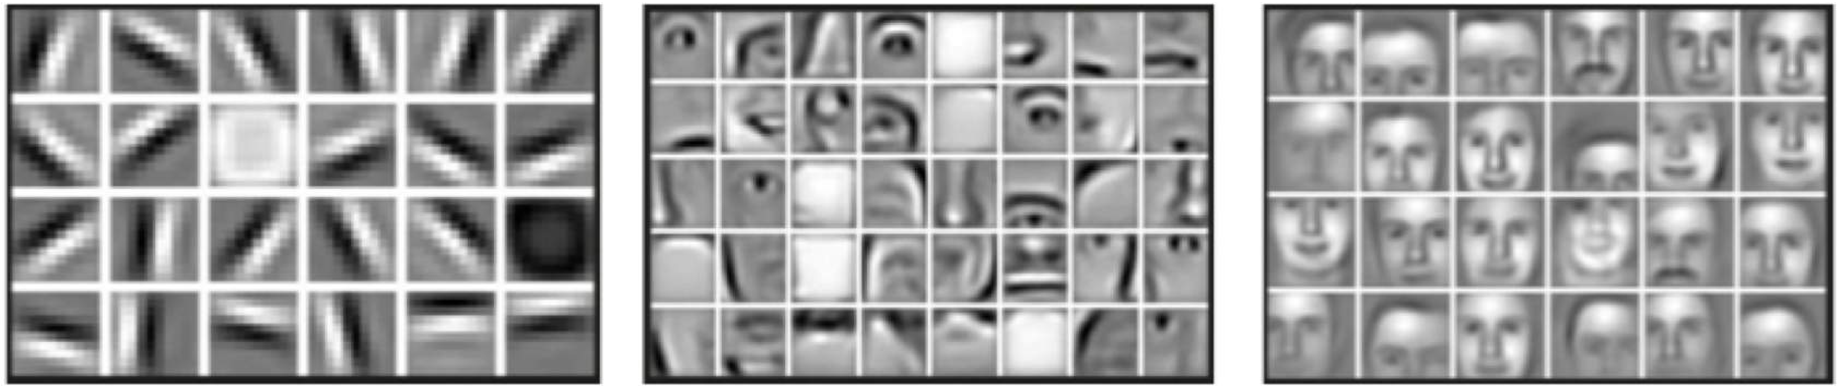
Why Deep Learning?
Hand engineered features are time consuming, brittle and not scalable in practice.
Can we learn the underlying features directly from data?
Low Level Features
Mid Level Features
High Level Features
Lines & Edges
Eyes & Nose & Ears
Facial Structure

Slide 10


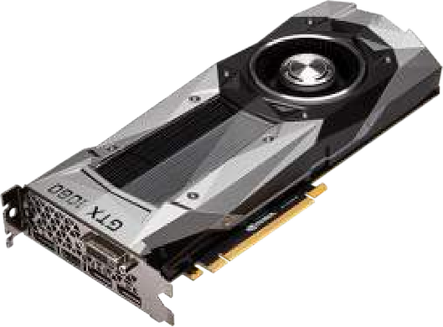

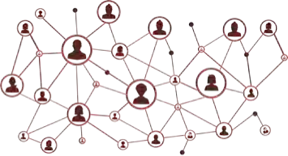
Why Now?
Neural Networks date back decades, so why the resurgence?
1952
Stochastic Gradient Descent
1. Big Data
Larger Datasets
Easier Collection & Storage
2. Hardware
3. Software
Improved Techniques
New Models
Toolboxes
1958
Perceptron
Learnable Weights
Graphics Processing Units (GPUs)
Massively Parallelizable
1986
Backpropagation
Multi-Layer Perceptron
1995
Deep Convolutional NN
Digit Recognition

Slide 11
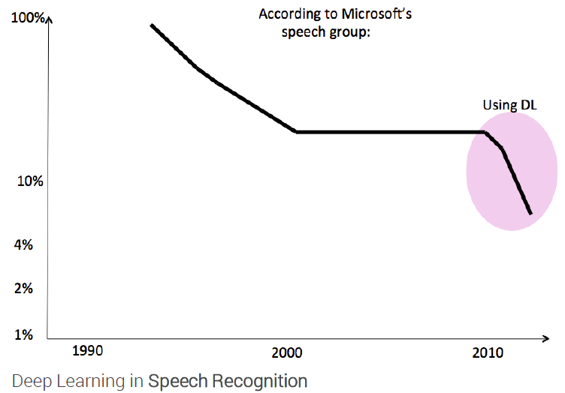
State of the art in …

Slide 12
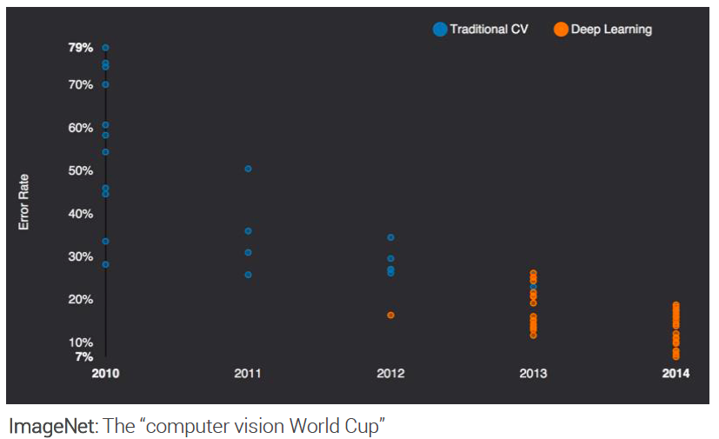
State of the art in …

Slide 13
State of the art in …
Several big improvements in recent years in NLP
Machine Translation
Sentiment Analysis
Dialogue Agents
Question Answering
Text Classification …
Leverage different levels of representation
words & characters
syntax & semantics

Slide 14
The Perceptron
The structural building block of deep learning

Slide 15

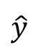
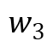
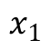
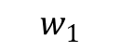
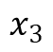
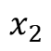
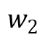
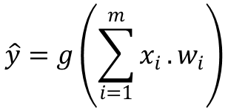
The Perceptron: Forward Propagation
Linear combination of inputs
Output
$$x_{1}$$
$$w_{1}$$
$$\hat{y}=g\left(\sum_{i=1}^{m}{x_{i}}.w_{i}\right)$$
$$w_{2}$$
Σ
$$x_{2}$$
$$\hat{y}$$
$$w_{3}$$
Non-linear activation function
$$x_{3}$$
Inputs
Weights
Sum
Non-Linearity
Output

Slide 16
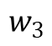
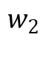
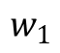
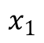
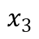
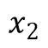
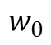
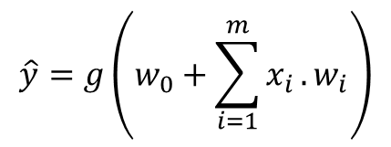
The Perceptron: Forward Propagation
Linear combination of inputs
1
Output
$$w_{0}$$
$$\hat{y}=g\left(w_{0}+\sum_{i=1}^{m}{x_{i}}.w_{i}\right)$$
$$x_{1}$$
$$w_{1}$$
Σ
$$\hat{y}$$
$$w_{2}$$
$$x_{2}$$
Non-linear activation function
Bias
$$w_{3}$$
$$x_{3}$$
Inputs
Weights
Sum
Non-Linearity
Output

Slide 17
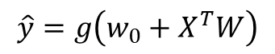
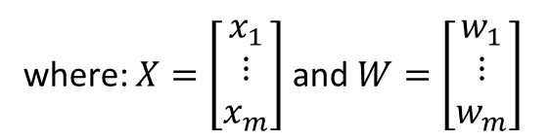
The Perceptron: Forward Propagation
1
$$w_{0}$$
$$\hat{y}=g\left(w_{0}+\sum_{i=1}^{m}{x_{i}}.w_{i}\right)$$
$$x_{1}$$
$$w_{1}$$
Σ
$$\hat{y}$$
$$w_{2}$$
$$x_{2}$$
$$\hat{y}=g\left(w_{0}+X^{T}W\right)$$
$$w_{3}$$
where: $X=\left[\begin{matrix}x_{1} \\ ⋮ \\ x_{m}\end{matrix}\right]$ and $W=\left[\begin{matrix}w_{1} \\ ⋮ \\ w_{m}\end{matrix}\right]$
$$x_{3}$$
Inputs
Weights
Sum
Non-Linearity
Output

Slide 18
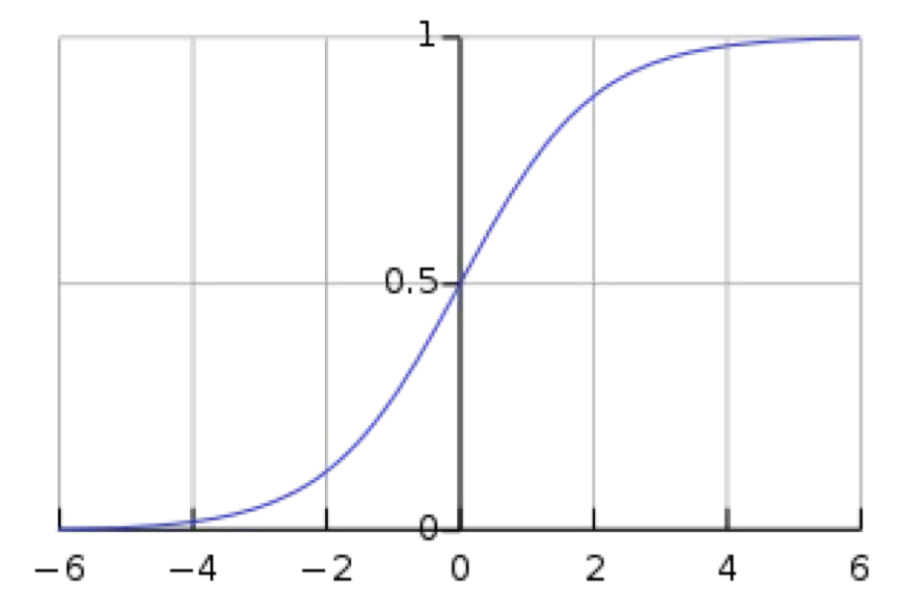
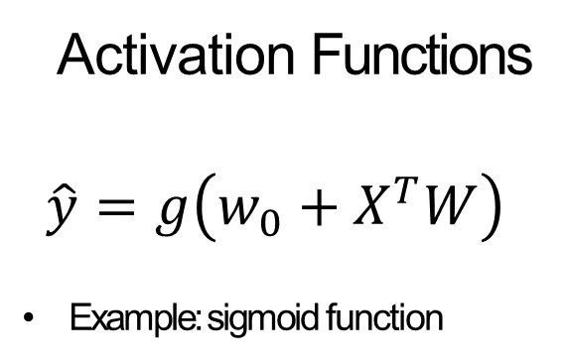
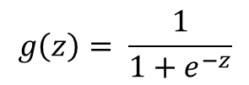
The Perceptron: Forward Propagation
Activation Functions
$$\hat{y}=g\left(w_{0}+X^{T}W\right)$$
Example: sigmoid function
1
$$w_{0}$$
$$x_{1}$$
$$w_{1}$$
Σ
$$\hat{y}$$
$$w_{2}$$
$$x_{2}$$
$$g\left(z\right)= \frac{1}{1+e^{−z}}$$
$$w_{3}$$
$$x_{3}$$
Inputs
Weights
Sum
Non-Linearity
Output
1

Slide 19
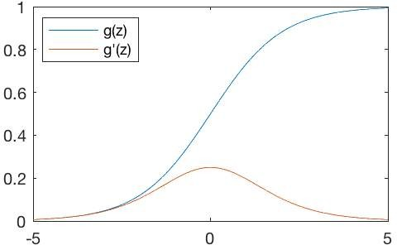
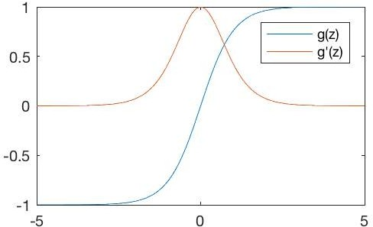
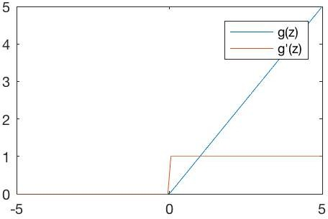



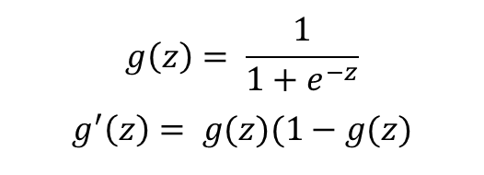
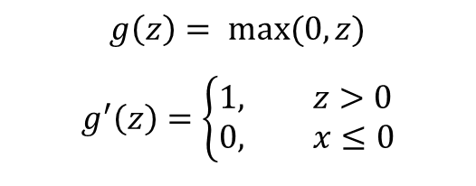
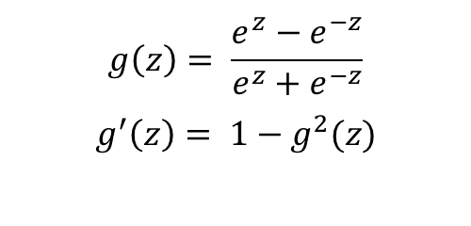
Common Activation Functions
Sigmoid Function
Hyperbolic Tangent
Rectified Linear Unit (ReLU)
$$g\left(z\right)= \frac{1}{1+e^{−z}}$$
$$g^{′}\left(z\right)= g(z)(1−g(z)$$
$$g\left(z\right)= \frac{e^{z}−e^{−z}}{e^{z}+e^{−z}}$$
$$g^{′}\left(z\right)= 1−g^{2}(z)$$
$$g\left(z\right)= max⁡(0,z)$$
$$g^{′}\left(z\right)=\left\{\begin{aligned}1, &z>0 \\ 0, &x≤0\end{aligned}\right.$$
tf.nn.sigmoid(z)
tf.nn.tanh(z)
tf.nn.relu(z)
NOTE: All activation functions are non-linear

Slide 20
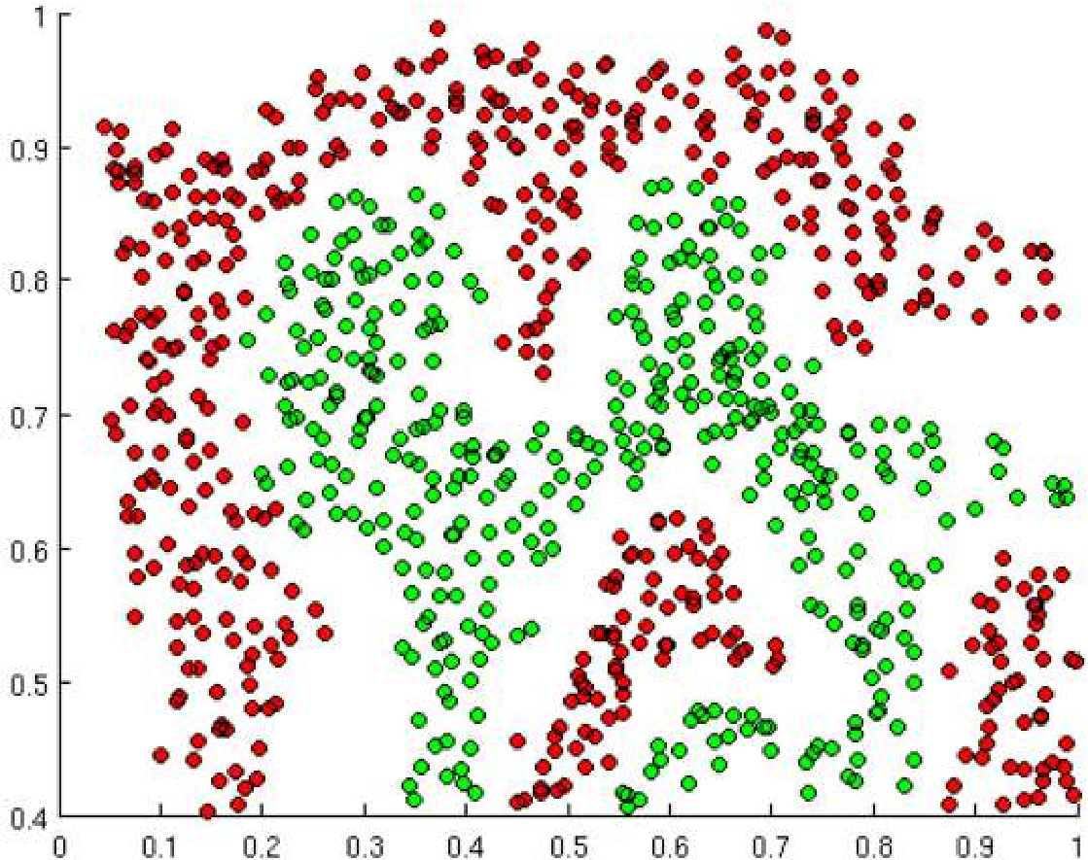
Importance of Activation Functions
The purpose of activation functions is to introduce non-linearities into the network
What if we wanted to build a Neural Network to distinguish green vs red points?

Slide 21
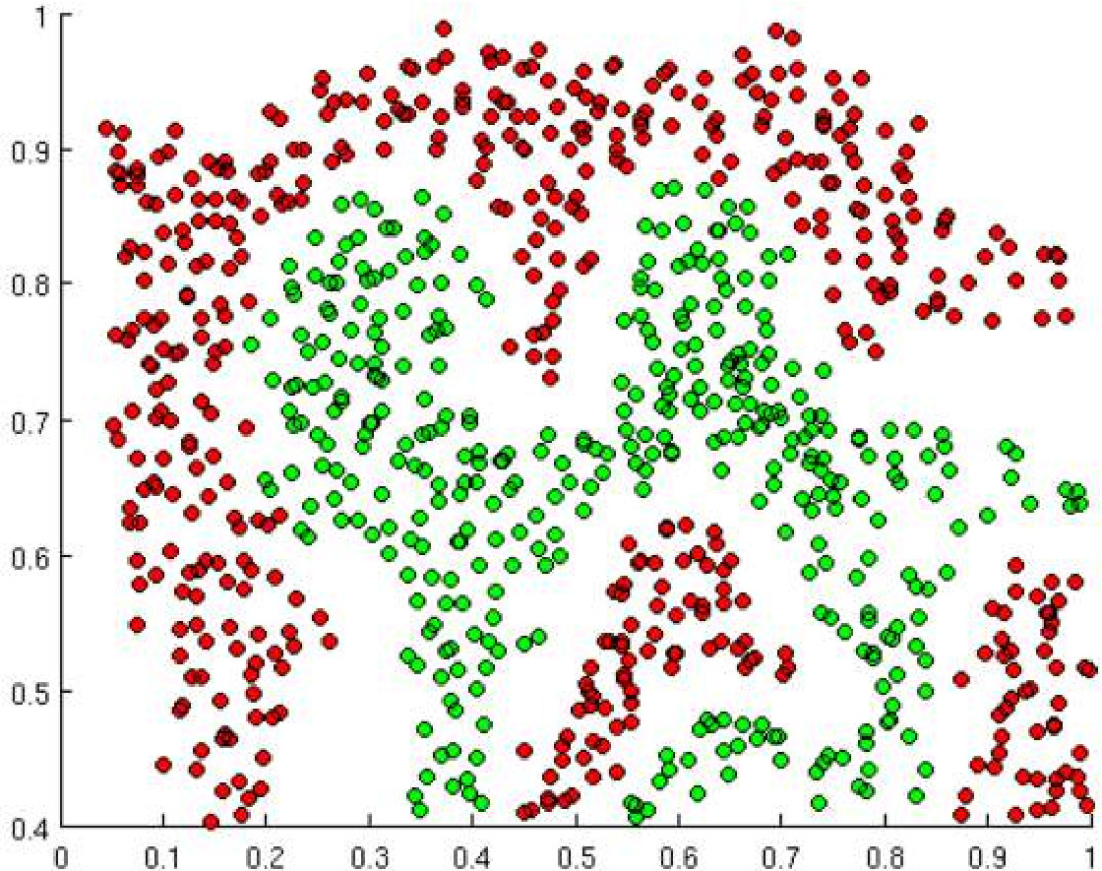
Importance of Activation Functions
The purpose of activation functions is to introduce non-linearities into the network
Linear Activation functions produce linear decisions no matter the network size

Slide 22
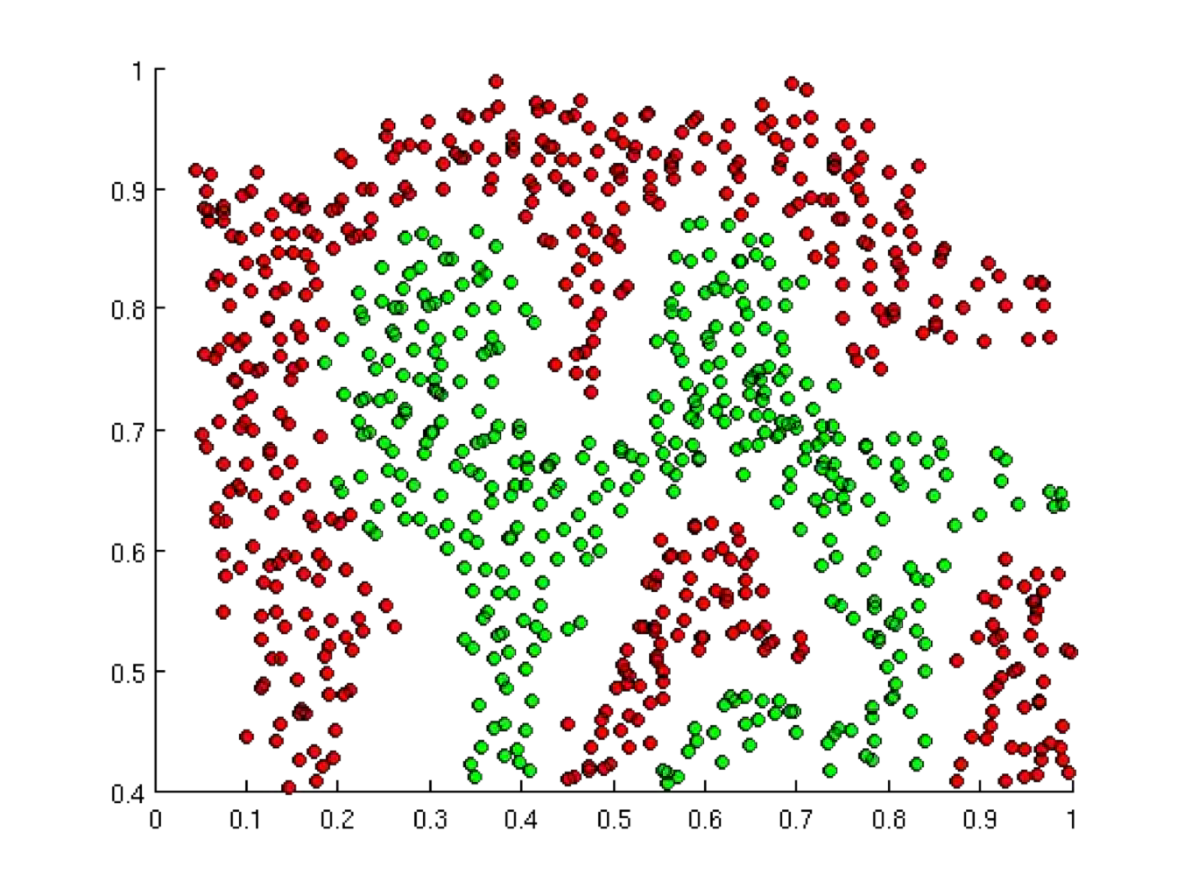
Importance of Activation Functions
The purpose of activation functions is to introduce non-linearities into the network
Linear Activation functions produce linear decisions no matter the network size
Non-linearities allow us to approximate arbitrarily complex functions

Slide 23
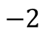


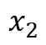
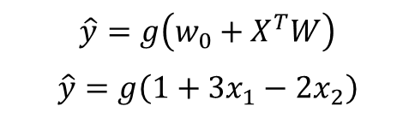
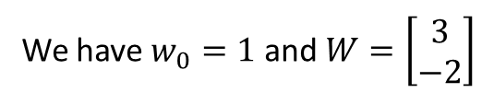
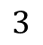
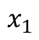
The Perceptron: Example
$$1$$
$$1$$
We have $w_{0}=1$ and $W=\left[\begin{matrix}3 \\ −2\end{matrix}\right]$
$$3$$
Σ
$$x_{1}$$
$$\hat{y}$$
$$\hat{y}=g\left(w_{0}+X^{T}W\right)$$
$$\hat{y}=g\left(1+3x_{1}−2x_{2}\right)$$
$$−2$$
$$x_{2}$$
This is just a line in 2D!

Slide 24
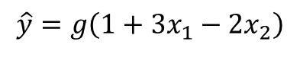
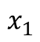
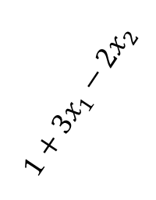

The Perceptron: Example
$$\hat{y}=g\left(1+3x_{1}−2x_{2}\right)$$
$$x_{2}$$
$$1$$
$$1$$
$$3$$
Σ
$$1+3x_{1}−2x_{2}$$
$$x_{1}$$
$$\hat{y}$$
$$−2$$
$$x_{1}$$
$$x_{2}$$

Slide 25



The Perceptron: Example
$$\hat{y}=g\left(1+3x_{1}−2x_{2}\right)$$
$$x_{2}$$
$$1$$
$$1$$
$$\left[\begin{matrix}−1 \\ 2\end{matrix}\right]$$
$$3$$
Σ
$$1+3x_{1}−2x_{2}$$
$$x_{1}$$
$$\hat{y}$$
$$−2$$
$$x_{1}$$
$$x_{2}$$
Assume we have input $I=\left[\begin{matrix}−1 \\ 2\end{matrix}\right]$
$$\hat{y}=g\left(6\right)≈0.002$$

Slide 26


The Perceptron: Example
$$\hat{y}=g\left(1+3x_{1}−2x_{2}\right)$$
$$x_{2}$$
$$1$$
$$1$$
$$z<0$$
$$y<0.5$$
$$3$$
Σ
$$1+3x_{1}−2x_{2}$$
$$x_{1}$$
$$\hat{y}$$
$$−2$$
$$x_{1}$$
$$x_{2}$$
$$z>0$$
$$y>0.5$$

Slide 27
Building Neural Networks with Perceptrons

Slide 28








The Perceptron: Simplified
1
$$w_{0}$$
$$x_{1}$$
$$w_{1}$$
Σ
$$\hat{y}$$
$$w_{2}$$
$$x_{2}$$
$$w_{3}$$
$$x_{3}$$
Inputs
Weights
Sum
Non-Linearity
Output

Slide 29






The Perceptron: Simplified
$$x_{1}$$
$$y=g(z)$$
$$x_{2}$$
$$y$$
$$x_{m}$$
$$y=g\left(w_{0}+\sum_{i=1}^{m}{x_{i}}.w_{i}\right)$$

Slide 30






Multi Output Perceptron
$$x_{1}$$
$$y_{1}$$
$$x_{2}$$
$$y_{2}$$
$$x_{m}$$
$$y_{i}=g\left(w_{0,i}+\sum_{j=1}^{m}{x_{j}}.w_{j,i}\right)$$

Slide 31












Single Layer Neural Network
$$W^{(1)}$$
$$y_{1,1}$$
$$W^{(2)}$$
$$x_{1}$$
$$y_{1,2}$$
$${\hat{y}}_{1}$$
$$x_{2}$$
$$y_{1,3}$$
$${\hat{y}}_{2}$$
$$x_{m}$$
$$y_{1,d_{1}}$$
Hidden
Inputs
Final Output

Slide 32

Multi Output Perceptron
from tf.keras.layers import *
inputs = Inputs(m)
hidden = Dense(d₁)(inputs) outputs = Dense(2)(hidden) model = Model(inputs, outputs)
$$y_{1,1}$$
$$x_{1}$$
$$y_{1,2}$$
$${\hat{y}}_{1}$$
$$x_{2}$$
$$y_{1,3}$$
$${\hat{y}}_{2}$$
$$x_{m}$$
$$y_{1,d_{1}}$$
Inputs
Hidden
Output

Slide 33









Deep Neural Network
$$y_{k,1}$$
$$x_{1}$$
⋯
$$y_{k,2}$$
⋯
$${\hat{y}}_{1}$$
$$x_{2}$$
$$y_{k,3}$$
$${\hat{y}}_{2}$$
$$x_{m}$$
$$y_{k,d_{1}}$$
Inputs
Hidden
Output

Slide 34
Applying Neural Networks

Slide 35

Example Problem
Will I pass this class?
Let’s start with a simple two feature model
$x_{1}$= Number of lectures you attend
$x_{2}$ = Hours spent on the final project

Slide 36


Example Problem: Will I pass this class?
$x_{2}=$ Hours spent on the final project
Legend
Pass Fail
$x_{1}$ = Number of lectures you attend

Slide 37

Example Problem: Will I pass this class?
$x_{2}$= Hours spent on the final project
Legend
Pass Fail
?
4
5
$x_{1}$ = Number of lectures you attend

Slide 38







Example Problem: Will I pass this class?
$$y_{1,1}$$
$$x_{1}$$
$$\left.x^{\left(1\right)}=[4, 5\right]$$
$$y_{1,2}$$
$$\hat{y}$$
Predicted: 0.1
$$x_{2}$$
$$y_{1,3}$$

Slide 39

Example Problem: Will I pass this class?
$$y_{1,1}$$
$$x_{1}$$
$$\left.x^{\left(1\right)}=[4, 5\right]$$
Predicted: 0.1
Actual: 1
$$y_{1,2}$$
$$\hat{y}$$
$$x_{2}$$
$$y_{1,3}$$

Slide 40

Quantifying Loss
The loss of our network measures the cost incurred from incorrect predictions
$$y_{1,1}$$
$$x_{1}$$
$$\left.x^{\left(1\right)}=[4, 5\right]$$
Predicted: 0.1
Actual: 1
$$y_{1,2}$$
$$\hat{y}$$
$$x_{2}$$
$$y_{1,3}$$
$$\left.ℒ(f\left(x^{\left(i\right)};W\right),{ y}^{\left(i\right)}\right)$$
Predicted Actual

Slide 41







Empirical Loss
The empirical loss measures the total loss over our entire dataset
$$y_{1,1}$$
$$f(x)$$
$$y$$
$$X=\left[\begin{matrix}4, 5 \\ 2, 1 \\ 5, 8 \\ ⋮ ⋮\end{matrix}\right]$$
$$x_{1}$$
$$\left[\begin{matrix}0.1 \\ 0.8 \\ 0.6 \\ ⋮\end{matrix}\right]$$
$$\left[\begin{matrix}1 \\ 0 \\ 1 \\ ⋮\end{matrix}\right]$$
$$y_{1,2}$$
$$\hat{y}$$
$$x_{2}$$
$$y_{1,3}$$
$$J\left(W\right)= \frac{1}{n}\sum_{i=1}^{n}{\left.ℒ(f\left(x^{\left(i\right)};W\right),y^{\left(i\right)}\right)}$$
Also known as:
Objective function
Cost function
Empirical Risk
Predicted Actual

Slide 42

Binary Cross Entropy Loss
Cross entropy loss can be used with models that output a probability between 0 and 1
$$y_{1,1}$$
$$f(x)$$
$$y$$
$$X=\left[\begin{matrix}4, 5 \\ 2, 1 \\ 5, 8 \\ ⋮ ⋮\end{matrix}\right]$$
$$x_{1}$$
$$\left[\begin{matrix}0.1 \\ 0.8 \\ 0.6 \\ ⋮\end{matrix}\right]$$
$$\left[\begin{matrix}1 \\ 0 \\ 1 \\ ⋮\end{matrix}\right]$$
$$y_{1,2}$$
$$\hat{y}$$
$$x_{2}$$
$$y_{1,3}$$
$$J\left(W\right)= \frac{1}{n}\sum_{i=1}^{n}{\left[y^{\left(i\right)}\log\left(f\left(x^{\left(i\right)};W\right)\right)+\left(1−y^{\left(i\right)}\right)\log\left(1−f\left(x^{\left(i\right)};W\right)\right)\right]}$$
Actual Predicted Actual Predicted
loss = tf.reduce_mean( tf.nn.softmax_cross_entropy_with_logits(model.y, model.pred) )

Slide 43




Mean Squared Error Loss
Mean squared error loss can be used with regression models that output
continuous real numbers
$$y_{1,1}$$
$$f(x)$$
$$y$$
$$X=\left[\begin{matrix}4, 5 \\ 2, 1 \\ 5, 8 \\ ⋮ ⋮\end{matrix}\right]$$
$$x_{1}$$
$$\left[\begin{matrix}30 \\ 80 \\ 85 \\ ⋮\end{matrix}\right]$$
$$\left[\begin{matrix}92 \\ 20 \\ 95 \\ ⋮\end{matrix}\right]$$
$$y_{1,2}$$
$$\hat{y}$$
$$x_{2}$$
$$y_{1,3}$$
$$J\left(W\right)= \frac{1}{n}\sum_{i=1}^{n}{{\left[y^{\left(i\right)}−f\left(x^{\left(i\right)};W\right)\right]}^{2}}$$
Final Grades (percentage)
loss = tf.reduce_mean( tf.square(tf.subtract(model.y, model.pred) )

Slide 44
Training Neural Networks

Slide 45

Loss Optimization
We want to find the network weights that achieve the lowest loss
$$W^{∗}= arg\min_{W}{\frac{1}{n}\sum_{i=1}^{n}{ℒ(f\left(x^{\left(i\right)};W\right),y^{\left(i\right)})}}$$
$$W^{∗}= arg\min_{W}{J\left(W\right)}$$

Slide 46

Loss Optimization
We want to find the network weights that achieve the lowest loss
$$W^{∗}= arg\min_{W}{\frac{1}{n}\sum_{i=1}^{n}{ℒ(f\left(x^{\left(i\right)};W\right),y^{\left(i\right)})}}$$
$$W^{∗}= arg\min_{W}{J\left(W\right)}$$
Remember:
$$W=\left\{W^{\left(0\right)}, W^{\left(1\right)}, …\right\}$$

Slide 47





Loss Optimization
$$W^{∗}= arg\min_{W}{J\left(W\right)}$$
Remember:
Our loss is a function of the network weights!
$$J\left(w_{0}, w_{1}\right)$$
$$w_{1}$$
$$w_{0}$$

Slide 48

Loss Optimization
Randomly pick an initial $\left(w_{0}, w_{1}\right)$
$$J\left(w_{0}, w_{1}\right)$$
$$w_{1}$$
$$w_{0}$$

Slide 49

Loss Optimization
Compute gradient, $\frac{∂J(W)}{∂W}$
$$J\left(w_{0}, w_{1}\right)$$
$$w_{1}$$
$$w_{0}$$

Slide 50
Loss Optimization
Take small step in opposite direction of gradient
$$J\left(w_{0}, w_{1}\right)$$
$$w_{1}$$
$$w_{0}$$

Slide 51
Gradient Descent
Repeat until convergence
$$J\left(w_{0}, w_{1}\right)$$
$$w_{1}$$
$$w_{0}$$

Slide 52




Gradient Descent
Algorithm
weights = tf.random_normal(shape, stddev=sigma)
Initialize weights randomly $\sim ℵ(0,σ^{2})$
Loop until convergence:
2.1 Compute gradient, $\frac{∂J(W)}{∂W}$
2.2 Update weights, $W=W−η\frac{∂J(W)}{∂W}$
3. Return weights
grads = tf.gradients(ys=loss, xs=weights)
weights_new = weights.assign(weights – lr * grads)

Slide 53

Gradient Descent
Algorithm
weights = tf.random_normal(shape, stddev=sigma)
Initialize weights randomly $\sim ℵ(0,σ^{2})$
Loop until convergence:
2.1 Compute gradient, $\frac{∂J(W)}{∂W}$
2.2 Update weights, $W=W−\frac{∂J(W)}{∂W}$
3. Return weights
grads = tf.gradients(ys=loss, xs=weights)
weights_new = weights.assign(weights – lr * grads)

Slide 54






Computing Gradients: Backpropagation
$$w_{1}$$
$$w_{2}$$
$$x$$
$$z_{1}$$
$$\hat{y}$$
$$J\left(W\right)$$
How does a small change in one weight (e.g $w_{2})$ affect the final loss $J\left(W\right)$ ?

Slide 55

Computing Gradients: Backpropagation
$$w_{1}$$
$$w_{2}$$
$$x$$
$$z_{1}$$
$$\hat{y}$$
$$J\left(W\right)$$
$$\frac{\left.∂J(W\right)}{∂w_{2}}=$$
Let’s use the chain rule!

Slide 56



Computing Gradients: Backpropagation
$$w_{1}$$
$$w_{2}$$
$$x$$
$$z_{1}$$
$$\hat{y}$$
$$J\left(W\right)$$
$$\frac{\left.∂J(W\right)}{∂w_{2}}=\frac{\left.∂J(W\right)}{∂\hat{y}}∗\frac{∂\hat{y}}{∂w_{2}}$$

Slide 57


Computing Gradients: Backpropagation
$$w_{1}$$
$$w_{2}$$
$$x$$
$$z_{1}$$
$$\hat{y}$$
$$J\left(W\right)$$
$$\frac{\left.∂J(W\right)}{∂w_{1}}=\frac{\left.∂J(W\right)}{∂\hat{y}}∗\frac{∂\hat{y}}{∂w_{1}}$$
Apply chain rule!
Apply chain rule!

Slide 58



Computing Gradients: Backpropagation
$$w_{1}$$
$$w_{2}$$
$$x$$
$$z_{1}$$
$$\hat{y}$$
$$J\left(W\right)$$
$$\frac{\left.∂J(W\right)}{∂w_{1}}=\frac{\left.∂J(W\right)}{∂\hat{y}}∗\frac{∂\hat{y}}{∂z_{1}}∗\frac{∂z_{1}}{∂w_{1}}$$

Slide 59


Computing Gradients: Backpropagation
$$w_{1}$$
$$w_{2}$$
$$x$$
$$z_{1}$$
$$\hat{y}$$
$$J\left(W\right)$$
$$\frac{\left.∂J(W\right)}{∂w_{1}}=\frac{\left.∂J(W\right)}{∂\hat{y}}∗\frac{∂\hat{y}}{∂z_{1}}∗\frac{∂z_{1}}{∂w_{1}}$$
Repeat this for every weight in the network using gradients from later layers

Slide 60
Neural Networks in Practice: Optimization

Slide 61

Training Neural Networks is Difficult
“Visualizing the loss landscape of neural nets”. Dec 2017.

Slide 62

Loss Functions Can Be Difficult to Optimize
Remember:
Optimization through gradient descent
$$W=W−η\frac{∂J(W)}{∂W}$$

Slide 63
Loss Functions Can Be Difficult to Optimize
Remember:
Optimization through gradient descent
$$W=W−η\frac{∂J(W)}{∂W}$$
How can we set the learning rate?

Slide 64


Setting the Learning Rate
$$\left.J(W\right)$$

Slide 65
How to deal with this?
Idea 1:
Try lots of different learning rates and see what works “just right”

Slide 66
How to deal with this?
Idea 1:
Try lots of different learning rates and see what works “just right”
Idea 2:
Do something smarter!
Design an adaptive learning rate that “adapts” to the landscape

Slide 67
Adaptive Learning Rates
Learning rates are no longer fixed
Can be made larger or smaller depending on:
how large gradient is
how fast learning is happening
size of particular weights
etc...

Slide 68





Adaptive Learning Rate Algorithms
Momentum
Adagrad
Adadelta
Adam
RMSProp
Qian et al. “On the momentum term in gradient descent learning algorithms.” 1999.
tf.train.MomentumOptimizer
Duchi et al. “Adaptive Subgradient Methods for Online Learning and Stochastic Optimization.” 2011.
tf.train.AdagradOptimizer
tf.train.AdadeltaOptimizer
Zeiler et al. “ADADELTA: An Adaptive Learning Rate Method.” 2012.
tf.train.AdamOptimizer
Kingma et al. “Adam: A Method for Stochastic Optimization.” 2014.
tf.train.RMSPropOptimizer
Additional details: http://ruder.io/optimizing-gradient-descent/

Slide 69
Neural Networks in Practice: Mini-batches

Slide 70


Gradient Descent
Algorithm
Initialize weights randomly $\sim ℵ(0,σ^{2})$
Loop until convergence:
2.1 Compute gradient, $\frac{∂J(W)}{∂W}$
2.2 Update weights, $W=W−\frac{∂J(W)}{∂W}$
3. Return weights

Slide 71
Gradient Descent
Algorithm
Initialize weights randomly $\sim ℵ(0,σ^{2})$
Loop until convergence:
2.1 Compute gradient, $\frac{∂J(W)}{∂W}$
2.2 Update weights, $W=W−\frac{∂J(W)}{∂W}$
3. Return weights
Can be very computational to compute!

Slide 72

Stochastic Gradient Descent
Algorithm
Initialize weights randomly $\sim ℵ(0,σ^{2})$
Loop until convergence:
2.1 Pick single data point $i$
2.2 Compute gradient, $\frac{∂J_{i}(W)}{∂W}$
2.3 Update weights, $W=W−η\frac{∂J_{i}(W)}{∂W}$
3. Return weights

Slide 73
Stochastic Gradient Descent
Algorithm
Initialize weights randomly $\sim ℵ(0,σ^{2})$
Loop until convergence:
2.1 Pick single data point $i$
2.2 Compute gradient, $\frac{∂J_{i}(W)}{∂W}$
2.3 Update weights, $W=W−η\frac{∂J_{i}(W)}{∂W}$
3. Return weights
Easy to compute but very noisy (stochastic)!

Slide 74

Stochastic Gradient Descent
Algorithm
Initialize weights randomly $\sim ℵ(0,σ^{2})$
Loop until convergence:
2.1 Pick a batch of $B$ single data points
2.2 Compute gradient, $\frac{∂J(W)}{∂W}=\frac{1}{B}\sum_{i=1}^{B}{\frac{∂J_{i}(W)}{∂W}}$
2.3 Update weights, $W=W−η\frac{∂J(W)}{∂W}$
3. Return weights

Slide 75
Stochastic Gradient Descent
Algorithm
Initialize weights randomly $\sim ℵ(0,σ^{2})$
Loop until convergence:
2.1 Pick a batch of $B$ single data points
2.2 Compute gradient, $\frac{∂J(W)}{∂W}=\frac{1}{B}\sum_{i=1}^{B}{\frac{∂J_{i}(W)}{∂W}}$
2.3 Update weights, $W=W−η\frac{∂J(W)}{∂W}$
3. Return weights
Fast to compute and a much better
estimate of the true gradient!

Slide 76
Mini-batches while training
More accurate estimation of gradient
Smoother convergence Allows for larger learning rates

Slide 77
Mini-batches while training
More accurate estimation of gradient
Smoother convergence Allows for larger learning rates
Mini-batches lead to fast training!
Can parallelize computation + achieve significant speed increases on GPU’s

Slide 78
Neural network tutorials
TensorFlow playground
https://playground.tensorflow.org

Slide 79
Introduction to TensorFlow, Keras

Slide 80
Why use Keras?
Keras is a high-level neural networks API, written in Python and capable of running on top of TensorFlow, CNTK, or Theano
Keras follows best practices for reducing cognitive load.
It is easy to learn and easy to use.
Notes:
Keras is an API designed for human beings, not machines. Keras follows best practices for reducing cognitive load: it offers consistent & simple APIs, it minimizes the number of user actions required for common use cases, and it provides clear and actionable feedback upon user error.
This makes Keras easy to learn and easy to use. As a Keras user, you are more productive, allowing you to try more ideas than your competition, faster -- which in turn helps you win machine learning competitions.
This ease of use does not come at the cost of reduced flexibility: because Keras integrates with lower-level deep learning languages (in particular TensorFlow), it enables you to implement anything you could have built in the base language. In particular, as tf.keras, the Keras API integrates seamlessly with your TensorFlow workflows.

Slide 81

Why use Keras?
Notes:
With over 250,000 individual users as of mid-2018, Keras has stronger adoption in both the industry and the research community than any other deep learning framework except TensorFlow itself (and the Keras API is the official frontend of TensorFlow, via the tf.keras module).

Slide 82

Notes:
With over 250,000 individual users as of mid-2018, Keras has stronger adoption in both the industry and the research community than any other deep learning framework except TensorFlow itself (and the Keras API is the official frontend of TensorFlow, via the tf.keras module).

Slide 83
Tutorials
“Hello World” deep learning
https://jupyter.org/install.html
Basic classification
https://www.tensorflow.org/tutorials/keras/basic_classification

